Slide 1

Video Summarize
Supervisor: M. Kamran Abid
Presented by: Muhammad Yousaf Khan (2k20-bscs-151)
Department of Computer Science, NFC institute of Engineering and Technology, Multan

Slide 2
Outline
Introduction
Background
Problem statement
Proposed solution
Use case
Activity diagram
Sequence diagram
Function and non-functional requirements
Novelty
interface
Testing
implementation

Slide 3

Introducation
The Video Summarizer System advanced technologies such as speech recognition and natural language processing to extract audio from videos and convert it into concise summaries.
This not only saves time for the users but also enhances productivity by enabling them to consume more information in less time.

Slide 4
Background
Our web application aims to improve upon existing software by offering
Comprehensive Language Support
Enhanced Accuracy
User-Friendly Interface
Multilingual support for transcription and translation.
State-of-the-art speech recognition and NLP for accurate transcriptions and summaries.
Easy-to-use features for uploading videos, generating summaries, and translating content.

Slide 5
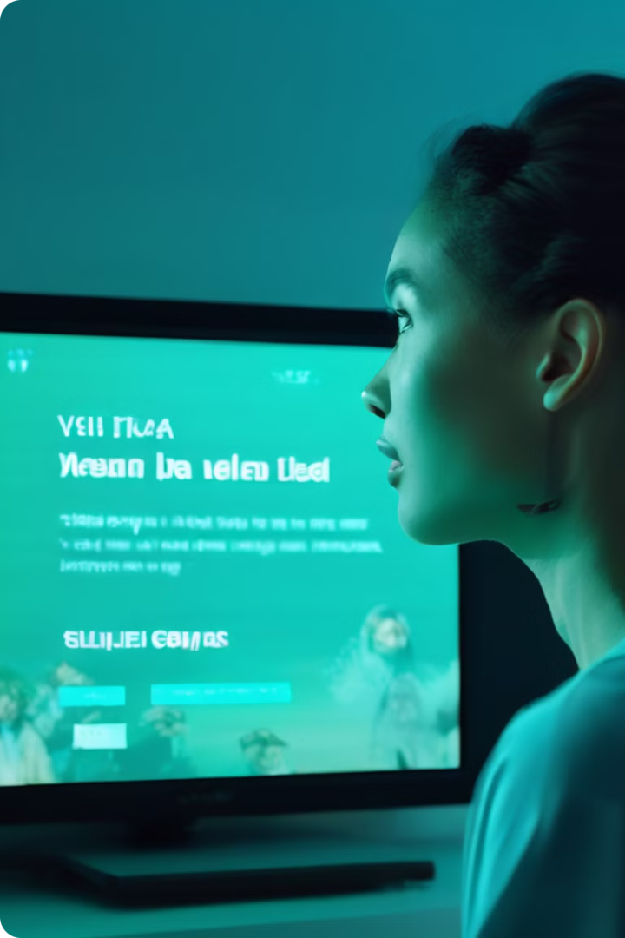
Problem Statement
Problem Statement
The need to watch entire videos to find specific information. It contrasts this with our solution, where the user receives a summary, saving time and effort.

Slide 6

Proposed Solution
Video Upload and Processing: The web application will provide users with an interface to upload video files. Once uploaded, the application will process the video using advanced speech recognition technology to transcribe the audio content into text.
Summary Generation: Using natural language processing (NLP) techniques, the transcribed text will be analyzed and summarized to capture the essential points of the video content. The summarized text will be concise and coherent, ensuring that users can quickly grasp the main ideas without watching the entire video.

Slide 7
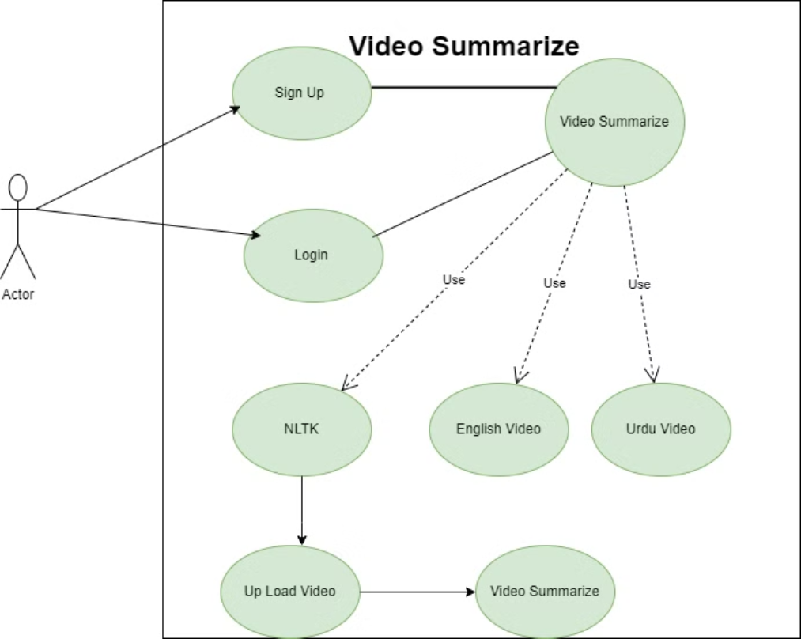
Use Case

Slide 8
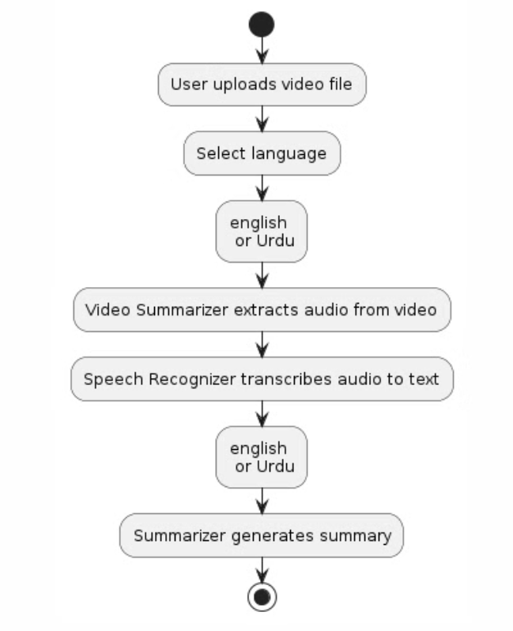
Activity Diagram

Slide 9
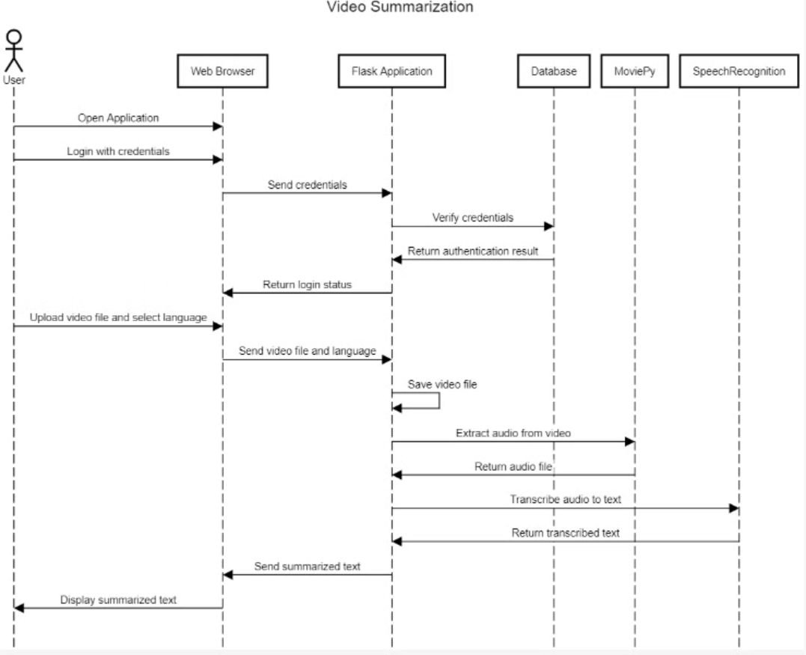
Sequence Diagram

Slide 10

Function and Non-Functional Requirements
Function Requirements | Non-Functional Requirements
User authentication system | User-friendly interface for ease of use.
Video upload capability | Fast processing time to generate summaries.
Language selection for audio recognition. | Secure storage and handling of user data
Display of summarized text to the user. | Error notifications for unsupported files or recognition issues

Slide 11
Novelty
Our web application stands out in the market due to several innovative features and improvements over existing solutions:
Advanced Multi Language Support:
Unlike many existing tools, our application supports transcription and summarization in multiple languages. This feature ensures that users from different backgrounds can easily access and understand the summarized content.
State-of-the-Art NLP Algorithms:
Our application utilizes cutting-edge natural language processing algorithms to generate accurate and coherent summaries. These algorithms can handle various accents and noisy environments, providing reliable transcriptions and summaries.

Slide 12
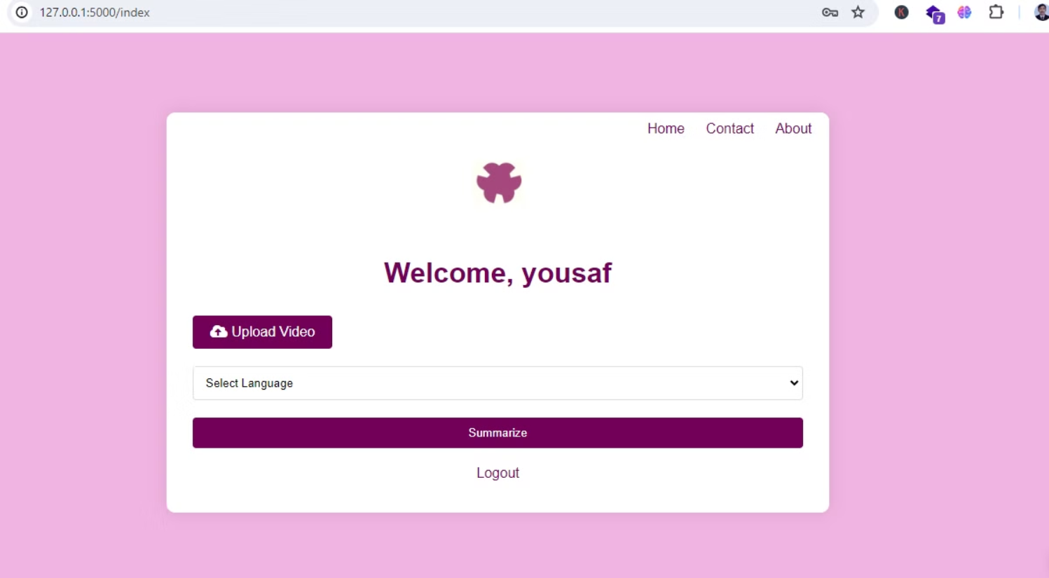
Interface

Slide 13
Testing
Overview of Testing
The testing process involved various techniques to cover all aspects of the application, from functionality to performance and usability.
Testing Techniques
Unit Testing: Unit tests were conducted to check individual components of the app. For example, tests were written to verify the correctness of the user authentication functions, video upload functionality, and audio processing methods.
Whitebox Testing: Whitebox testing involved testing the internal structures and workings of the app. This method was used to test specific pieces of code, such as functions for audio extraction and speech recognition, ensuring they performed as expected.

Slide 14
Implementaation
Video Upload: Users can easily upload video files in supported formats.
Language Selection: Users have the option to choose the language of the video for accurate speech recognition.
Audio Extraction: The application automatically extracts audio from uploaded videos for processing.
Speech Recognition: Utilizing advanced speech recognition technology, the app transcribes audio into text.
Summarization: Users receive a summarized text version of the video's content for quick review and reference.
User Authentication: Secure user authentication ensures only registered users can access the application.

Slide 15


